Slide 1
National Health and Nutrition Examination Survey
(NHANES)
Group Members:
Nibedita Bal, William Ranick, Hima Spandana Barla

Slide 2
Background
The National Health and Nutrition Examination Survey (NHANES)is a program of studies designed to assess the health and nutritional status of adults and children in the United States.
NHANES has the responsibility for producing vital and health statistics for the Nation.
Our goal is to draw out significant relationships in the data , identify significant variables in understanding research questions.

Slide 3

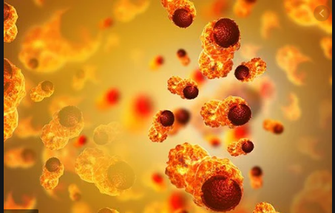
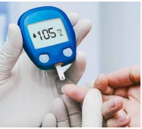
Dataset: National Health and Nutrition Examination Survey (NHANES)
Source: https://www.kaggle.com/cdc/national-health-and-nutrition-examination-survey, 2016

Slide 4
Literature Review
Association between body size and blood pressure in children from different ethnic origins
Five ethnic groups such as Dutch, Turkish, Moroccan, Black-African and Black-Caribbean were examined. Linear regression was used to examine non-linear associations between body size and blood pressure.
Ethnic differences were found in associations of Body Mass Index and Blood Pressure.
Strongest associations with blood pressure were found for Body Mass Index in all ethnic groups.
de Hoog, M. L. A., van Eijsden, M., Stronks, K., Gemke, R. J. B. J., & Vrijkotte, T. G. M. (2012). Association between body size and blood pressure in children from different ethnic origins. Cardiovascular Diabetology, 11(1), 136–145. https://doi-org.ezproxy.depaul.edu/10.1186/1475-2840-11-136

Slide 5
Literature Review 2
Relationship between perceived stress and dietary intakes in type 2 diabetes patients
This examines separately negative/positive perceived stress effect on dietary intake.
High carbohydrate intake had higher negative perceived stress
Stress was the independent variable. Covariates were age, education, marital status, diabetes duration and income.
A positive perception of stress may lead to healthy food choices and negative perceived stress to the unhealthy dietary patterns.
Dehghan, P., Pourmoradian, S., Mahdavi, A. M., Sarmadi, B., & Mehralizadeh, S. (2016). Relationship between Perceived Stress and Dietary Intakes in Type 2 Diabetic Patients. Current Topics in Nutraceutical Research, 14(3), 199–205.
Notes:
Hima B

Slide 6
Literature Review 3
The association between circulating levels of vitamin D and inflammatory markers in the first 2 years after colorectal cancer diagnosis
Correlation between serum Vitamin D and the progression of colorectal cancer is observed.
Higher serum levels of Vitamin D was correlated with lower levels of cytokine IL-6
Since cytokine levels were generally low across the entire experiment, it was difficult for researchers to ascertain if the reduction in IL-6 was truly significant.
Wesselink, E., Balvers, M., Bours, M. J. L., de Wilt, J. H. W., Witkamp, R. F., van Baar, H., Geijsen, A. J. M. R., van Halteren, H., Keulen, E. T. P., Kok, D. E., Kouwenhoven, E. A., van den Ouweland, J., van Zutphen, M., Weijenberg, M. P., Kampman, E., & van Duijnhoven, F. J. B. (2020). The association between circulating levels of vitamin D and inflammatory markers in the first 2 years after colorectal cancer diagnosis. Therapeutic Advances in Gastroenterology, 13, 1–15. https://doi-org.ezproxy.depaul.edu/10.1177/1756284820923922

Slide 7
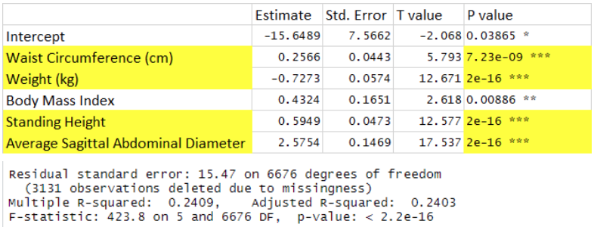
Methods:
Does Systolic blood pressure explain BMI?
Normality is checked by
Shapiro-Wilk test. wilcox test
was Chosen as the data was
not normal.
Waist Circumference,Weight (kg),
Height,Sagittal Abdominal Diameter
are very significant.

Slide 8
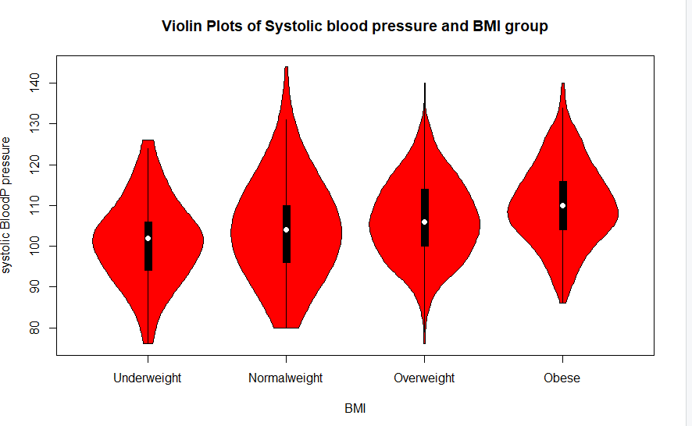
Visualization of Blood pressure and Age group

Slide 9
Conclusion of research question 1:
For Systolic blood pressure and BMI, it is concluded that five variables ,Waist area,weight, Body Mass Index, abdominal diameter do have impact on blood pressure as these variables are highly significant.
From this result, it is assumed that if a person has larger belly, higher Body Mass Index which means the person is overweight or obese , he is more prone to systolic blood pressure.
Children who are obese, in their eatrly youth stage, they suffer blood pressure early rather than youth who having good Body Mass Index.

Slide 10
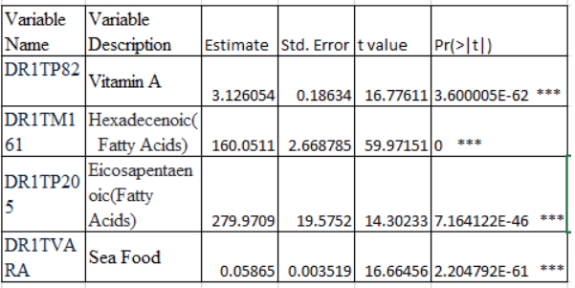
Multiple Regression
How diabetes diagnosis be predicted
from the diet and vitamins given to patients?
Vitamins - DR1TP182
Fatty acid - DR1TM161, DR1TP205
Seafood - DR1TVARA
Reject the null hypothesis and accept the
alternative.

Slide 11
Conclusion of research question 2:
Checked for multicollinearity and the variables are correlated to each other
Vitamins and fatty acids are highly significant and have influence over diabetes on the patients
Vitamin supplements can provide nutrients that the body needs for regular function and that are essential for blood sugar control and insulin sensitivity.
Increase consumption fatty acids and seafood as they will protect against, or even reverse, conditions such as diabetes

Slide 12
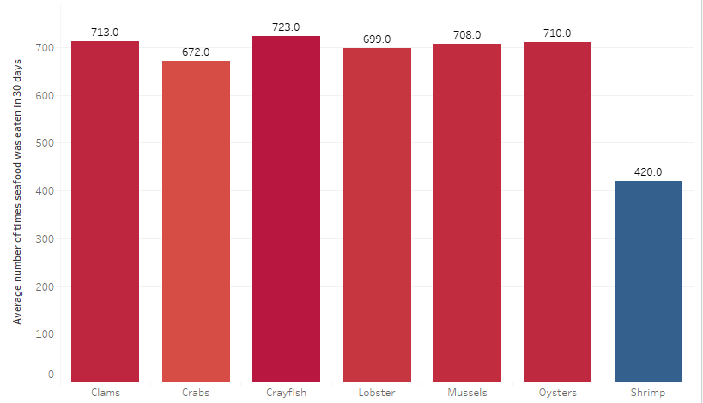
Average number of times seafood was eaten in 30 days by diabetic patients
Lobster (DRD350D),
Clams(DRD350E),
Crabs(DRD350B),
Mussels(DRD350E),
Oysters(DRD350F),
Crayfish (DRD350C) &
Shrimp(DRD350H)

Slide 13
Cancer and Vitamins - Logistic Regression
Data was selected from two data sets
Cancer Diagnosis (binary)
Daily intake of 60+ vitamins and other organic compounds (quantitative)
Checked for multicollinearity
Performed backwards elimination from full model to create final model
Tested trained data with model to assess model accuracy.

Slide 14
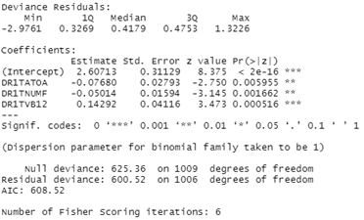

Conclusion of Research Question 3
Vitamin E and # of meals eaten daily appeared to be positively correlated with cancer diagnosis.
Vitamin B12 appeared to be correlated with no cancer diagnosis (1 mcg decreases the log odds of being diagnosed with cancer by ~0.143).
The trained model, however, only correctly predicted cancer diagnosis in only 0.03% of test cases.
Vitamin E
Meals/Day
Vitamin B12
Image courtesy of Quickmeme.com

Slide 15
Limitations
We need a long term data but here the small duration(2 years) data might not give us accurate model.
The online dictionary of all variables include many variables that were not actually present in the data set.
The dietary data was logged as estimated vitamin intake for only a single day of patient measurement.
It is unclear how these variables could have been accessed.

Slide 16
Future work
The use of other methods such as generalized canonical correlation, principal component analysis, factor analysis could be used to analyze random variables, other than regression.
Some other mathematical methods that are used in performance evaluation and classification accuracy can be applied in the analysis to know the accuracy of the method.
Further studies can explore the relationship between ‘blood pressure’ and ‘bmi’ , diabetics and diet, cancer and vitamin intake based on the different machine learning techniques.

Slide 17
Conclusion
Several conclusions from these analyses:
For controlling blood pressure, it is important to manage weight, even for children.
Omega Fatty Acids (regularly found in seafood) are good for you and may help to prevent diabetes.
Vitamin intake may be important in preventing and slowing the progression of cancer.
Diet is an important part of overall health in ways that many might not realize. Abundant research shows that many illnesses and conditions can be controlled or prevented by paying attention to what you eat.

Slide 18
References
de Hoog, M. L. A., van Eijsden, M., Stronks, K., Gemke, R. J. B. J., & Vrijkotte, T. G. M. (2012). Association between body size and blood pressure in children from different ethnic origins. Cardiovascular Diabetology, 11(1), 136–145. https://doi-org.ezproxy.depaul.edu/10.1186/1475-2840-11-136
Wesselink, E., Balvers, M., Bours, M. J. L., de Wilt, J. H. W., Witkamp, R. F., van Baar, H., Geijsen, A. J. M. R., van Halteren, H., Keulen, E. T. P., Kok, D. E., Kouwenhoven, E. A., van den Ouweland, J., van Zutphen, M., Weijenberg, M. P., Kampman, E., & van Duijnhoven, F. J. B. (2020). The association between circulating levels of vitamin D and inflammatory markers in the first 2 years after colorectal cancer diagnosis. Therapeutic Advances in Gastroenterology, 13, 1–15. https://doi-org.ezproxy.depaul.edu/10.1177/1756284820923922
Dehghan, P., Pourmoradian, S., Mahdavi, A. M., Sarmadi, B., & Mehralizadeh, S. (2016). Relationship between Perceived Stress and Dietary Intakes in Type 2 Diabetic Patients. Current Topics in Nutraceutical Research, 14(3), 199–205.

